Slide 1

Visualization of Telegram news channels in Kazakhstan
Idoyatov Zufar
Zhashkeev Yerkanat
Kair Daniyal

Slide 2



Hypothesis
Hypothesis:
“different news channels carry different agendas”
Hypothesis justification:
some channels prefer to write about politics and positivity, some play with negativity and emotions or use jargon. Some embellish the news, some describe the truth as it is. For some cities the information might be biased. We would like to investigate these.

Slide 3
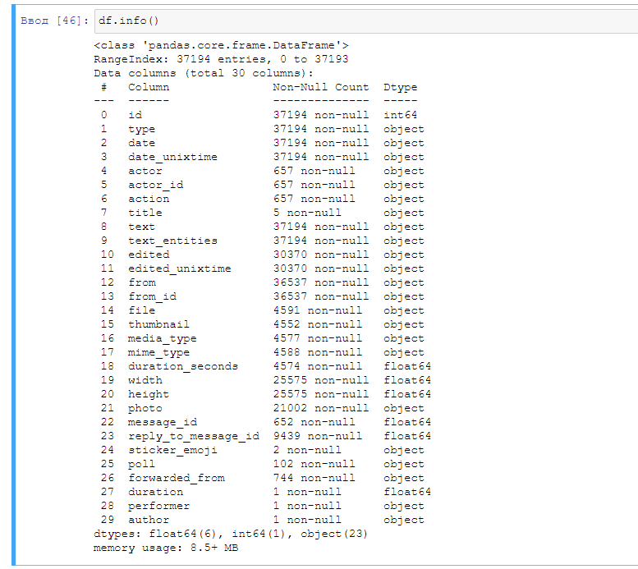
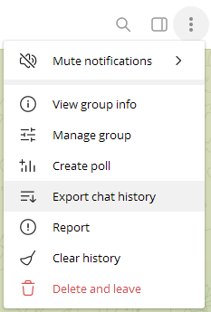
Dataset overview
As example, 37000 rows data exported from ORDA telegram channel. Others channels data also available

Slide 4
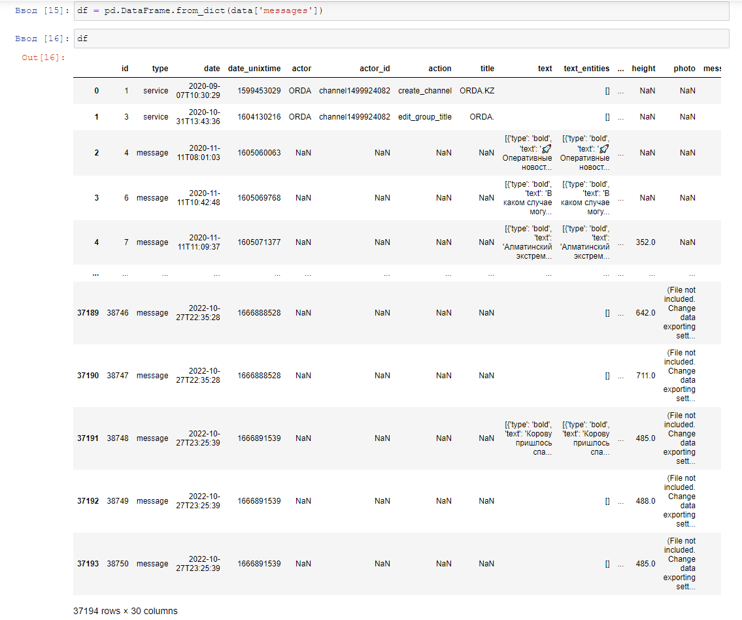
Dataset overview

Slide 5
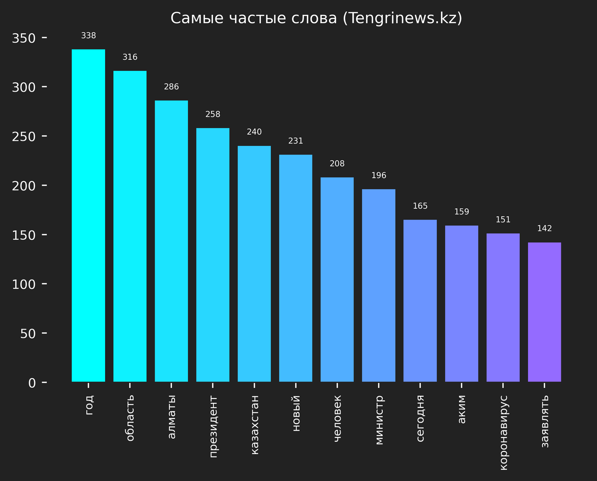
Bar charts overview

Slide 6
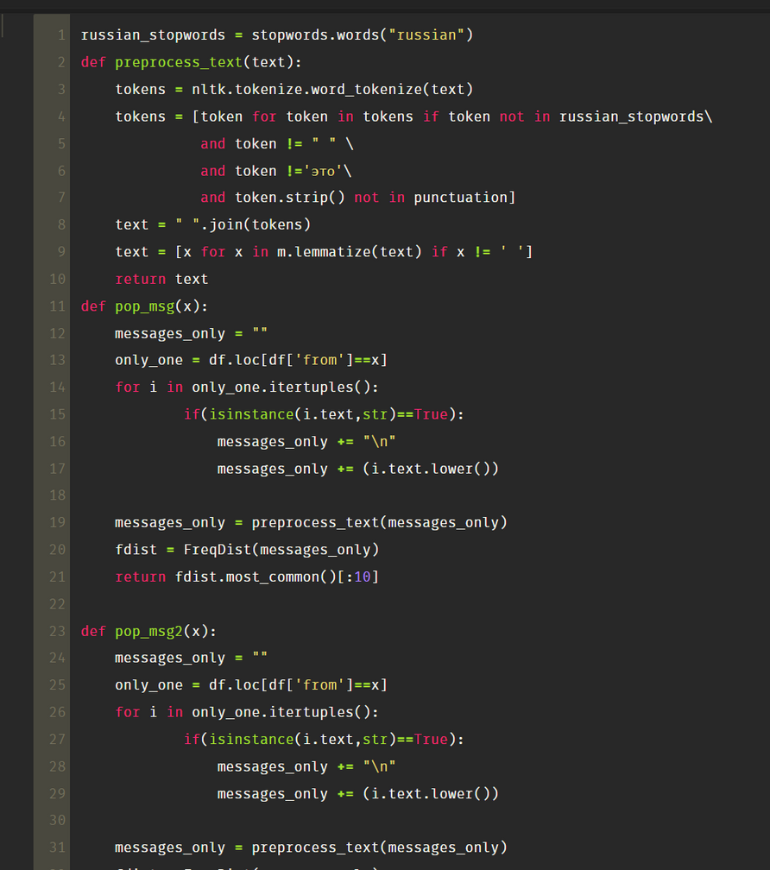
Data Preprocessing (nltk)

Slide 7
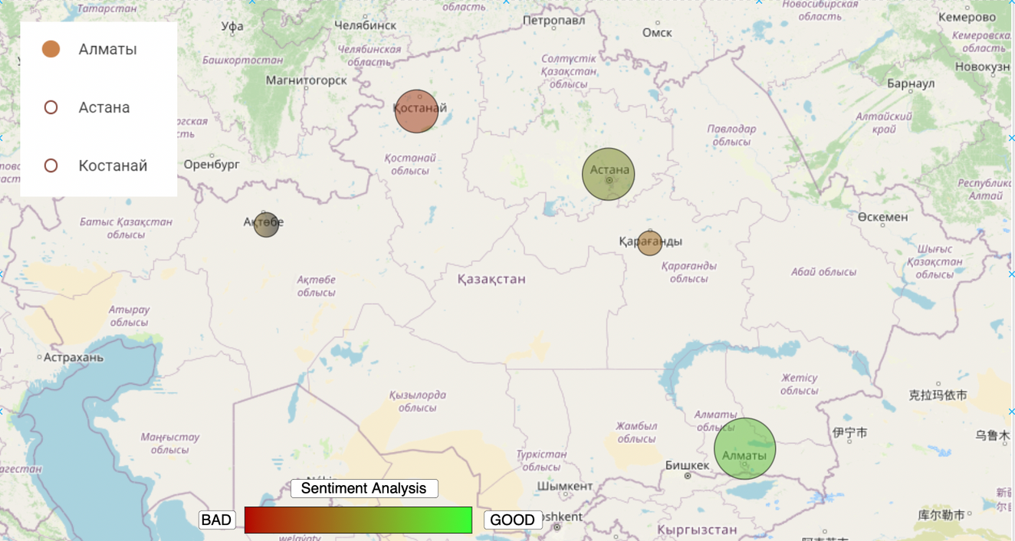
map overview

Slide 8
Critical Paths of Information Dissemination in Networks
http://sv-journal.org/2022-2/09/en.pdf
code not attached to article
Social networks and instant messaging platforms represent a field for research on information signals. The tasks of such research are to determine the nature of propagation, to reveal the relationships between individual subjects/objects, and to build the predictive model of propagation.
Two tasks were solved in the work: the analysis of information dissemination in Telegram
for the most popular channels (30 channels in the initial sample) and the consideration of individual information signals. The analysis of channel interaction potentially allows identifying "opinion leaders", "aggregators" of information and bursts of forwarding activity.
395 795 informational messages were collected in the Telegram messenger over the 3 months period, then they were converted for graph representation, visualization was performed using the Gephi tool. That tool was chosen due to the user-friendly interface and the possibility of adding a dynamic component.
First, the graph for 30 channels and their output to external sources was plotted (Figure 2). In this figure channels for which messages were collected are highlighted in green, and those channels from which redirection took place are highlighted in red. Node size is directly proportional to the number of messages that were forwarded from this channel.

Slide 9
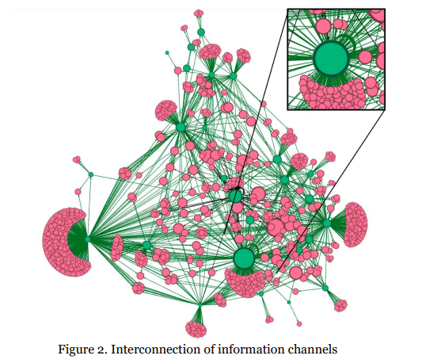
The graph shows a certain homogeneity of the information field in the center, which characterizes strong interrelations among the participants of the information field. Wide range of "buds" on the periphery indicates the number of channels being monitored. It is also possible to make preliminary conclusions about the amount of unique content generated by the channel. The more "dead-end" edges indicate the less unique content produced.

Slide 10
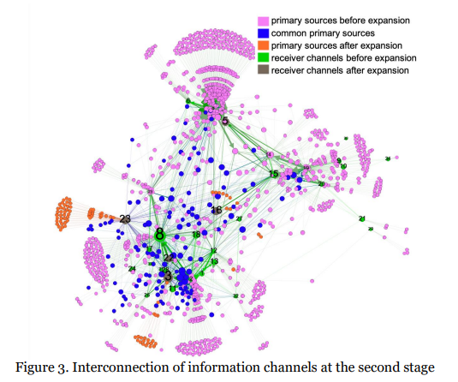
Graph is constructed to obtain overall statistics by channel (Figure 3)
graph was constructed with the dynamic component by the date of forwarding to the target channel.
This approach allows estimating the flow of forwarded messages for different time intervals. The data sample presents the 3 months period of 2022, which is shown in the figure (by converting timestamp to date), we can see the burst of publications in the middle of the sample (about 20%), which indicates a significant newsworthy event that occurred in this time interval. In addition, we can note the timing of the interaction between the isolated channels (for example, “16”, “33”, “34”) and more central channels.

Slide 11
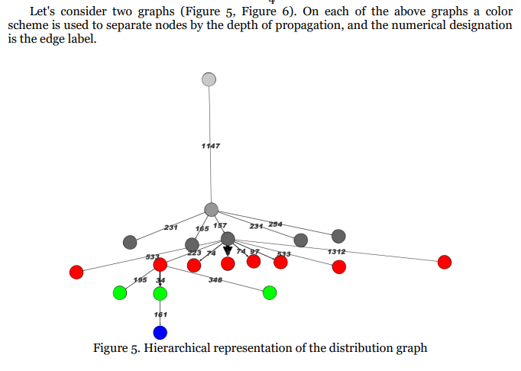
Two features can be emphasized on the first graph. First, some posts are forwarded almost immediately, while others are forwarded much later. On the other hand, some posts are forwarded to the exact minute, although they take quite a long time. For example, the first graph highlights edges with forwarding times of 231 minutes at level 2; with forwarding times of 74 and 533 minutes at level 3. Since there are 3 pairs of completely identical edges out of 18 edges (by time and absence of child elements) there is an assumption about the connection of channels-receivers in pairs with each other or about intentional forwarding of information signals.

Slide 12
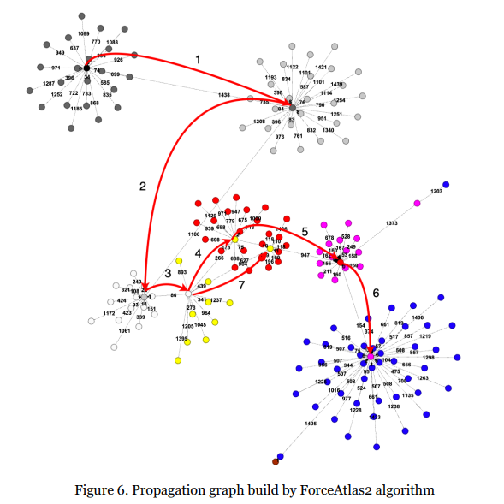
The second graph represents one of the largest propagation networks, containing 165 nodes and a maximum depth of 7. The ForceAtlas 2 visualization algorithm has adequately placed the nodes by propagation depth.
This example highlights the chain of nodes that corresponds to the main propagation. In the majority of cases, messages are forwarded from these nodes, indicating that these channels are authoritative.
The identified chain is associatively similar to the critical path of the Gantt chart used in project management theory.

Slide 13
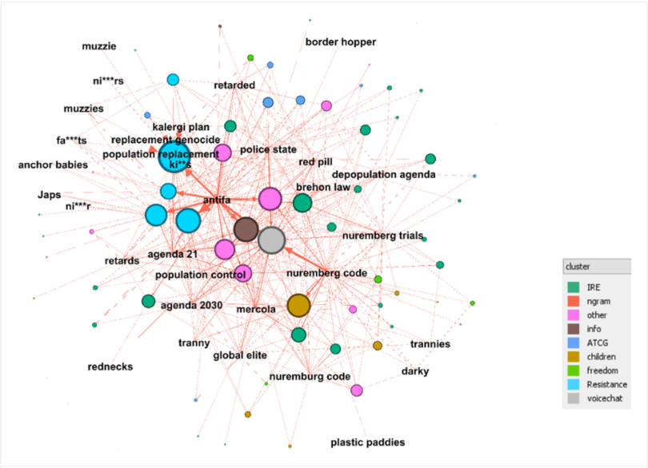
Covid-19 Protesters and the Far Right on Telegram: Co-Conspirators or
Accidental Bedfellows?
code not attached to article
https://journals.sagepub.com/doi/full/10.1177/20563051221129187
in Figure visualized mentions of terms from the Hatebase lexicon (extended with BoW terms). The nodes in this bipartite graph are the groups and the terms associated with hate speech or other far-right narratives. Groups and supergroups are grouped into clusters, these are displayed in different colors on the graph, according to cluster.

Slide 14
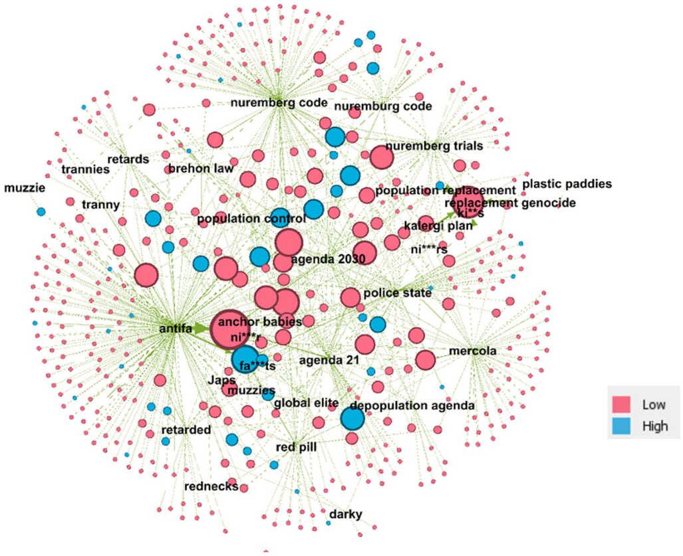
In figure vizualizes identification of actors posting far-right or hate content was based solely on text search on the text posts of groups or supergroups. To examine this, for each actor identified as posting content relating to hate terms and/or far-right narratives, the figure highlights levels of privilege. They define privilege as having at least one elevated role in the groups in which they have posted the hate-based or far-right content such as administrator, creator, or first poster.

Slide 15
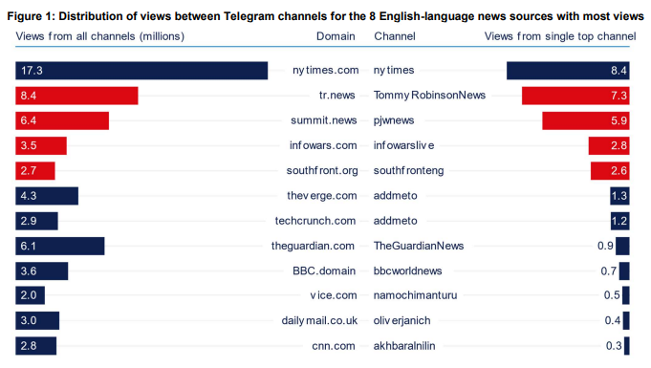
JUNK NEWS DISTRIBUTION ON TELEGRAM:
The Visibility of English-language News Sources on Public Telegram Channels
https://demtech.oii.ox.ac.uk/wp-content/uploads/sites/127/2020/07/Junk-News-Distribution-on-Telegram.-Data-Memo.pdf
Messaging platforms such as Telegram are key channels for the dissemination of misinformation and junk news. So far there are very few large-scale studies of how news and political content circulates on these platforms. In this article used a large open access dataset to analyze which English-language news sources are prevalent on public Telegram channels, the scale of their audience and how information spreads on the platform. The study is based on an open access dataset that includes 317 million Telegram messages sent to 28,000 public Telegram channels between 2015 and 2020.

Slide 16
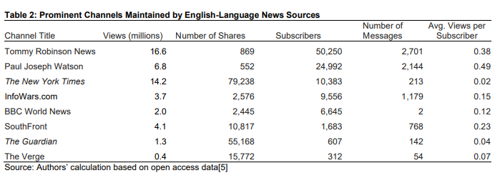
Junk news sources received a third of all the views on Telegram for the most prominent twelve news sources we examined.
Mainstream news sources receive a lot of attention, but two of the junk news sources received more views on Telegram than some well-known mainstream news outlets, including the Guardian or Daily Mail.
There is a fairly large audience for junk news sources, but articles from these sources rarely circulated widely outside of channels dedicated to these sources.
The audiences of junk news channels are on average significantly more engaged than the audiences of mainstream news channels. However, with a relatively small user base and no algorithmic timeline, these channels struggle to build a larger audience on Telegram.
code not attached to article

Slide 17
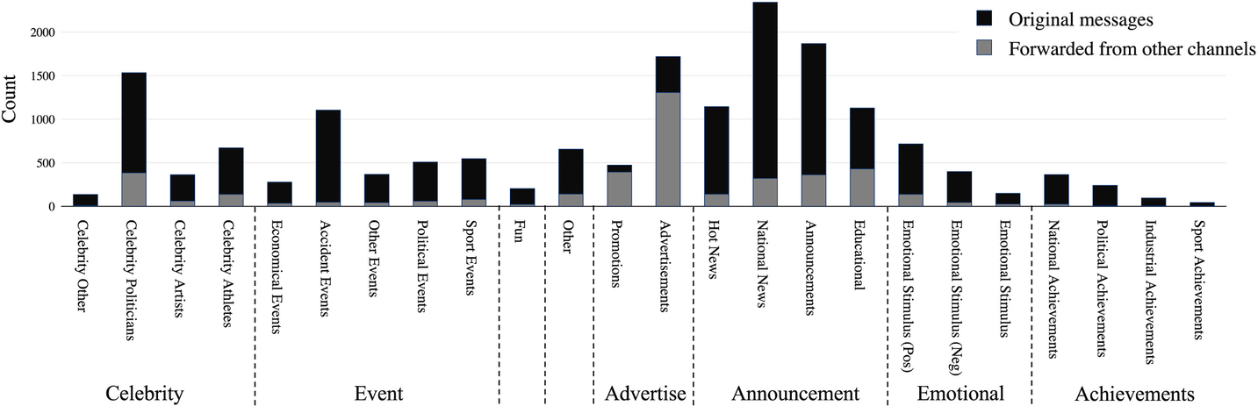
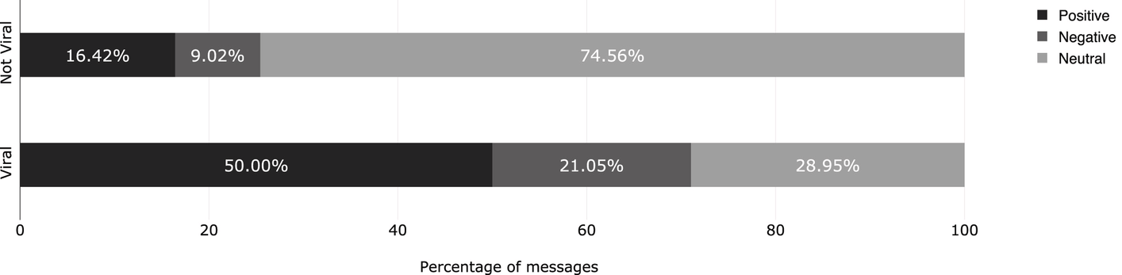
Some random vizualization ideas

Slide 18

Thank you for your attention

